Slide 1
Superstore Sales Analysis
INDAH DEWI LESTARI
Andromeda – Team 1

Slide 2
TABLE OF CONTENTS
01
02
03
04
Overview
Problem Statement
About company and dataset
Business problem, Root cause analysis, Objective
Exploratory Data Analysis
Recommendation
Analyzing dataset
Recomenndation and insight

Slide 3




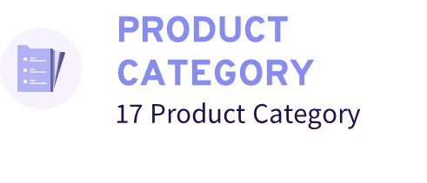

COMPANY OVERVIEW
Superstore Giant is an ecommerce company that sells office supplies products

Slide 4
BUSINESS PROBLEM
Sales growth rate decrease 6%
Profit growth rate decrease 11%
Average of Sales
Average of Profit

Slide 5
ROOT CAUSE ANALYSIS
Discount
Price
Sales and Profit Analysis
Time
Sales Decrease
Stock
Product
Marketing
Rating

Slide 6
OBJECTIVE
Analyze sales and profit to increase revenue 10% in a year

Slide 7
EXPLORATORY DATA ANALYSIS

Slide 8
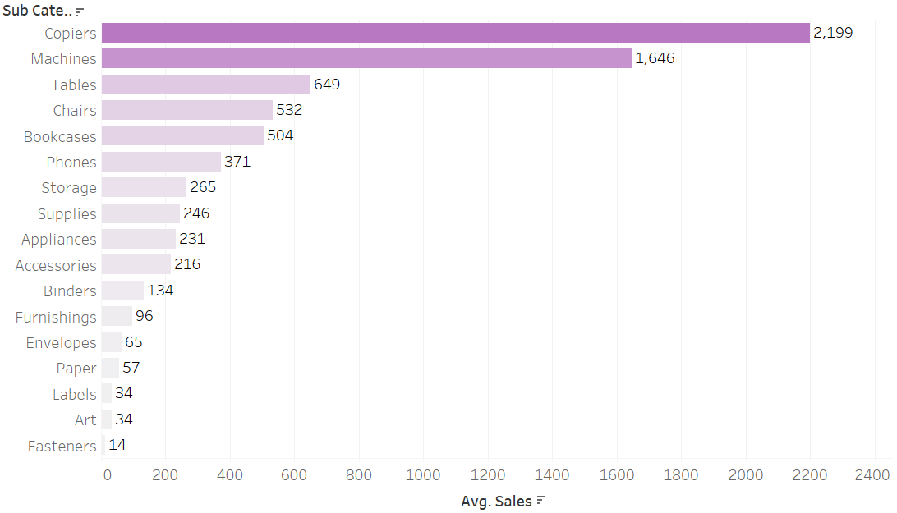
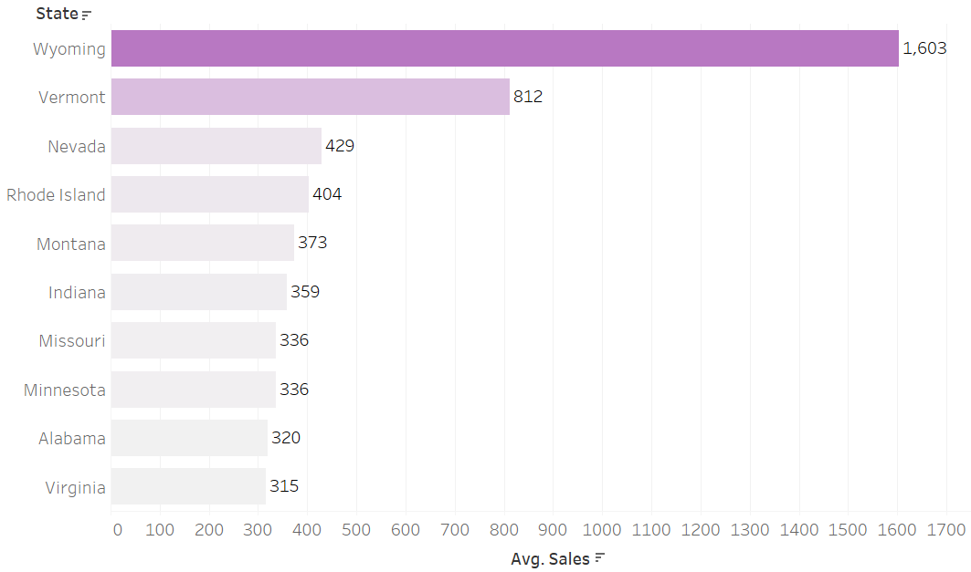
AVERAGE SALES ANALYSIS
The sub-category with the highest sales is copiers, with a sales value of $2,199
Wyoming is the state with the highest sales, amounting to $1,603

Slide 9

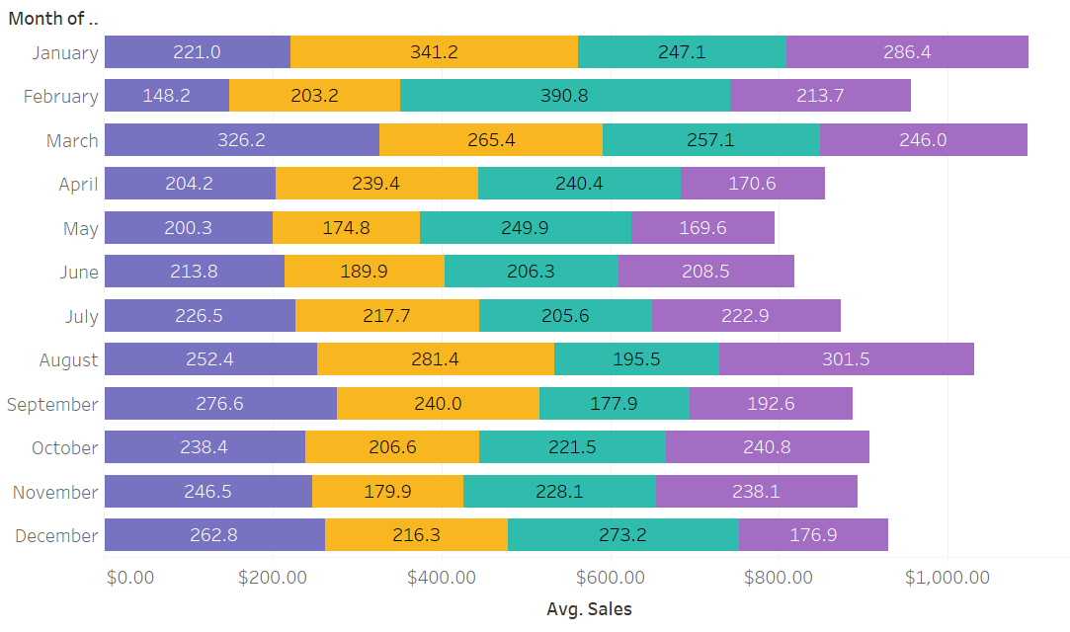
AVERAGE SALES ANALYSIS
The highest sales in January and then a decline in sales in the second quarter. February was the month with the most sales during 2018-2021
Sales gradually decreased, but there are ups and downs at every point in time

Slide 10
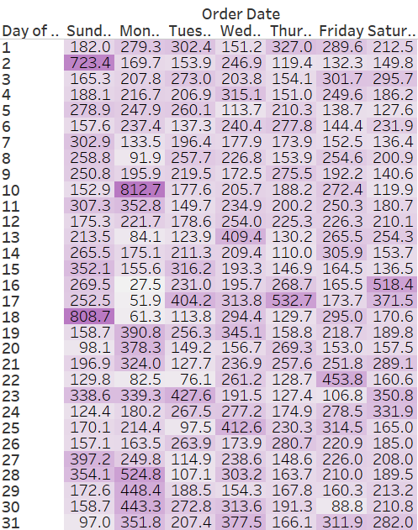
TIME SERIE: AVERAGE SALES ANALYSIS
Mondays on the 10th of each month generate the highest sales
Two other days, Sundays on the 18th of each month and Mondays on the 2nd of each month, also generate high sales. In addition to Mondays on the 10th, Sundays on the 18th and Mondays on the 2nd of each month show a similar pattern of high sales
Considering the entirety of the data, it can be concluded that Mondays, in general, have the highest daily sales compared to other days of the week.

Slide 11
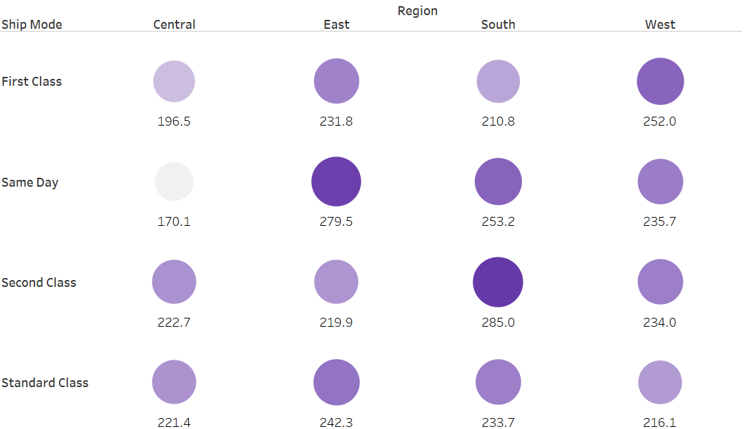
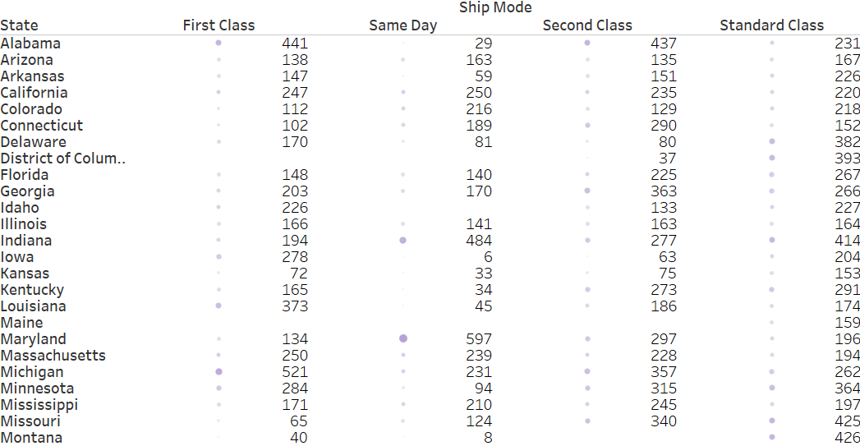
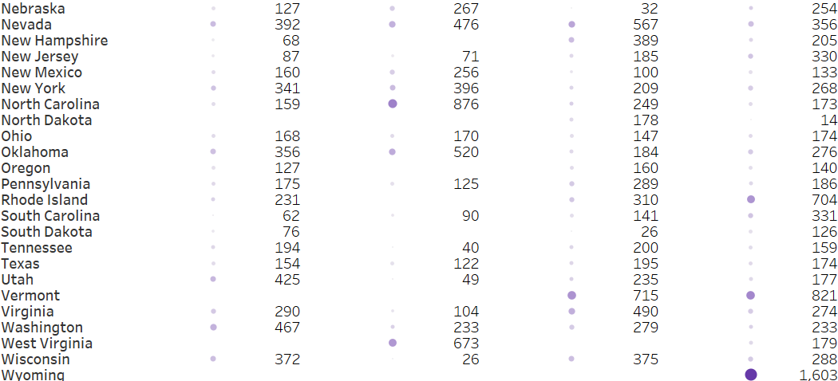
STORE ANALYSIS: SHIP MODE BY REGION AND STATE SALES
Wyoming is the state with the highest sales, amounting to $1,603. They use standard-class ship mode
North Carolina is ranked second in terms of sales, with a total of $876. They use same-day ship mode
Vermont is ranked third with sales amounting to $821. They use standard-class ship mode

Slide 12
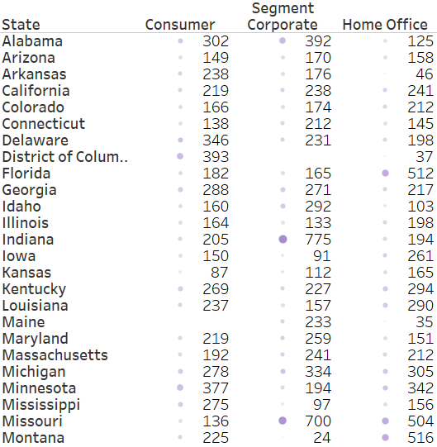
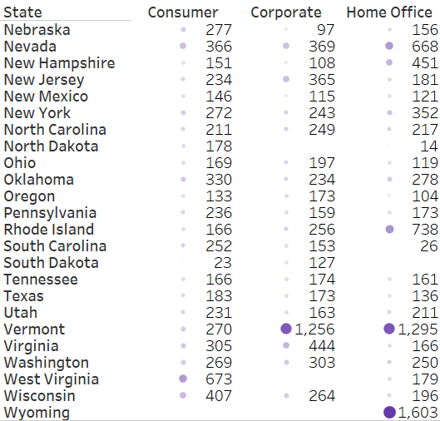
CUSTOMER ANALYSIS: STATE BY SEGMENT SALES
Wyoming stands out with the highest sales among all states. Specifically, the Home Office segment in Wyoming generated sales amounting to $1,603.
Moving on to Vermont, it is noteworthy that the state ranks second and third in terms of sales for the Home Office and Corporate segments, respectively. The Home Office segment in Vermont generated sales of $1,295, while the Corporate segment achieved sales of $1,256.

Slide 13
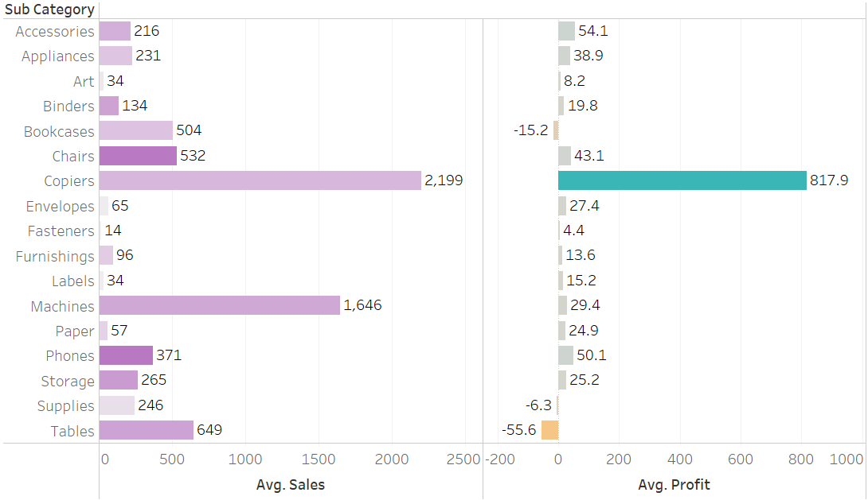
PROFIT ANALYSIS
Copiers have the highest sales of $2,199 and the highest profit of $817.9.
Several categories, including bookcases, supplies, and tables, have negative profits
The table category has sales data of $649, but it suffers the most losses or negative values in terms of profit, specifically -$55.6.

Slide 14
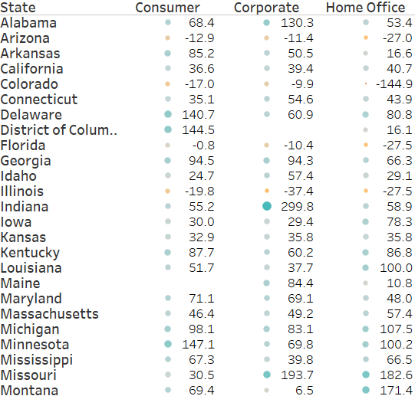
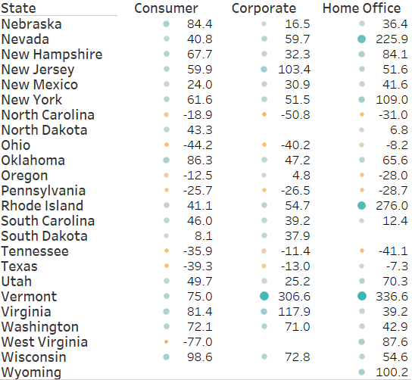
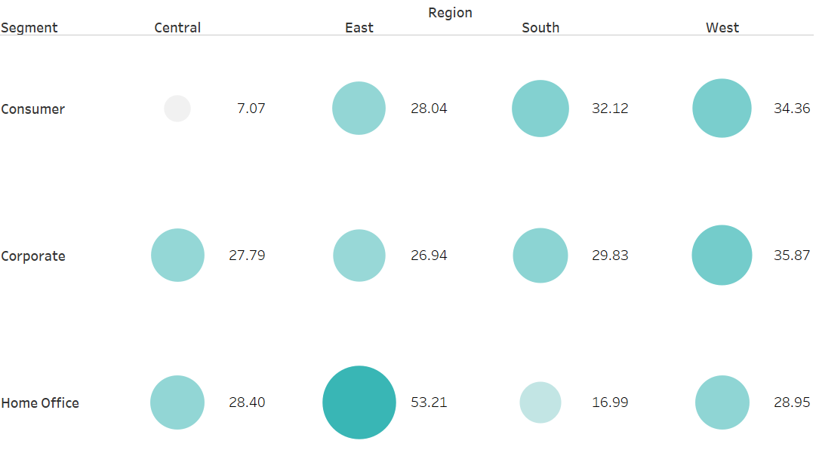
PROFIT ANALYSIS
The highest segment by region is the Home Office segment in the East region, with sales amounting to $53.21.
The highest segment by state is Vermont, with the Home Office segment generating sales of $336.6 and the Corporate segment generating sales of $306.6.
The second-highest segment is in Indiana, with sales amounting to $299.8 in the Corporate segment.

Slide 15
MARKET BASKET ANALYSIS
Product 1 | Product 2
Storage | Binder, Paper
Paper, Phone | Binder
Fastener | Paper
Appliances | Binder
Label | Storage
Binder | Fastener
Phone | Art
Tables | Phone
Storage | Furnishing
Furnishing | Appliances
Customers tend to purchase products 1 and 2 together.
The table is sorted based on the highest lift, indicating the association between the two products.
Paper and binder are more often purchased together with other products

Slide 16
RECOMMENDATION

Slide 17
RECOMMENDATION
Recommend product sales based on market basket analysis by creating "package deals" promotions (e.g., buy fastener and paper to get a discount/special price).
Create a promotion of "buy 2 get 1 free" based on basket analysis. For example, buy a phone and paper to get a binder.
Organize flash sales for products with low sales volume.
Reduce the amount of discount for products that do not generate profit.
Provide special rewards targeting corporate and home office segments, as they contribute the highest profits for long-term relationships.
Run campaigns targeting states with low sales.
Frequently offer discounts for ship modes with high sales.

Slide 18
THANKS!

